Slide 1


SIMATS ENGINEERING
Saveetha Institute of Medical and Technical Sciences
Chennai-602105.
CONTROLLING ROOM LIGHT INTENSITY USING AURDINO AND BLUETOOTH MODULE (HC-05)
Supervisor
Dr .Prema Kandasamy,
Dr . Dinakar Raj.
Professor,
SIMATS ENGINEERING
Student Name – Gnvsss Manikanta
Register Number : 192110672
Student Name – B Lakesh
Register Number : 192365037
Student Name - D.V.Sai Kumar
Register Number : 192372321

Slide 2

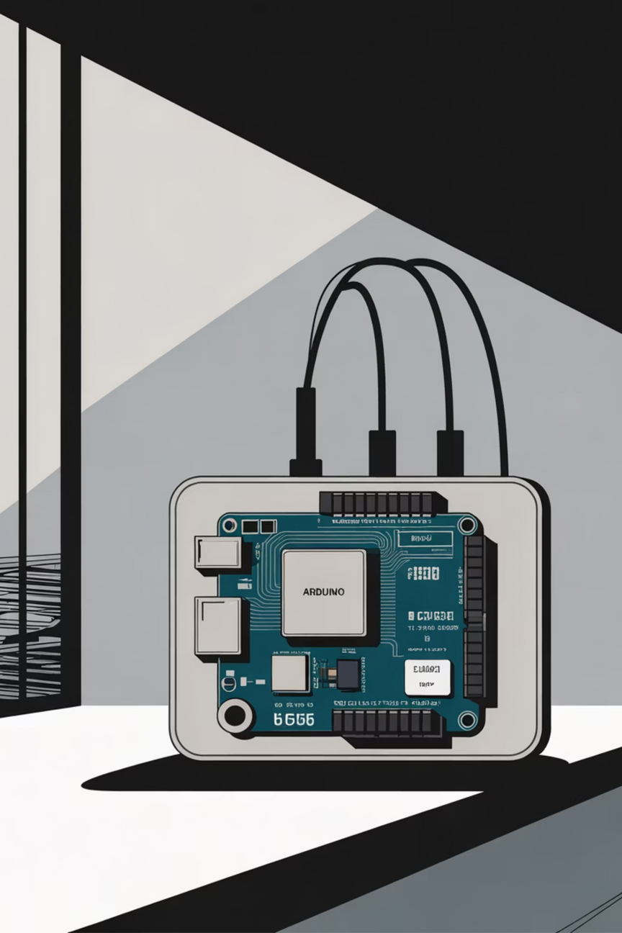


Controlling Room Light Intensity Using Arduino and Bluetooth Module (HC-05)
A low-cost, wireless solution for smart home lighting.
Notes:
1

Slide 3






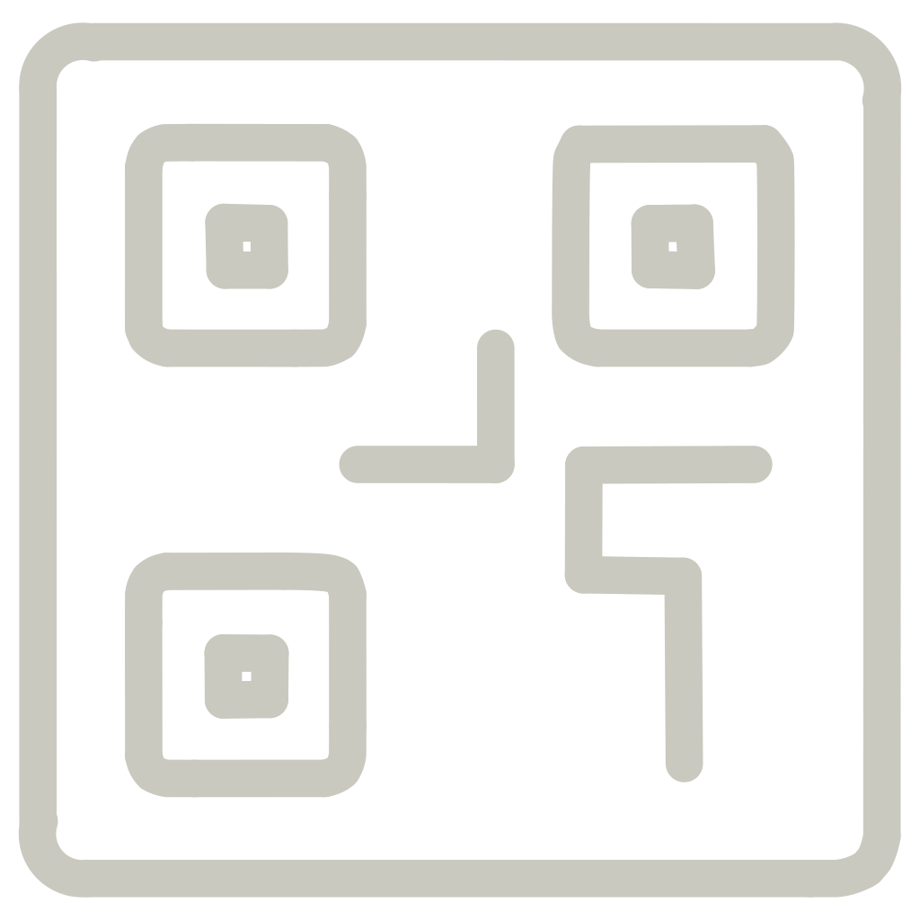

Project Overview: Smart Light Control via Bluetooth
This project demonstrates a practical application of embedded systems and wireless communication to create a responsive and intuitive lighting solution.
Remote Control
Adjust Intensity
Adjust light intensity wirelessly from a standard smartphone application.
Achieve smooth dimming effects, not just simple ON/OFF switching.
Three Key Modules
Core Technology
Microcontroller, Bluetooth Communication, and Light Control Hardware.
Powered by the Arduino Uno microcontroller and HC-05 Bluetooth module.
Notes:
2

Slide 4
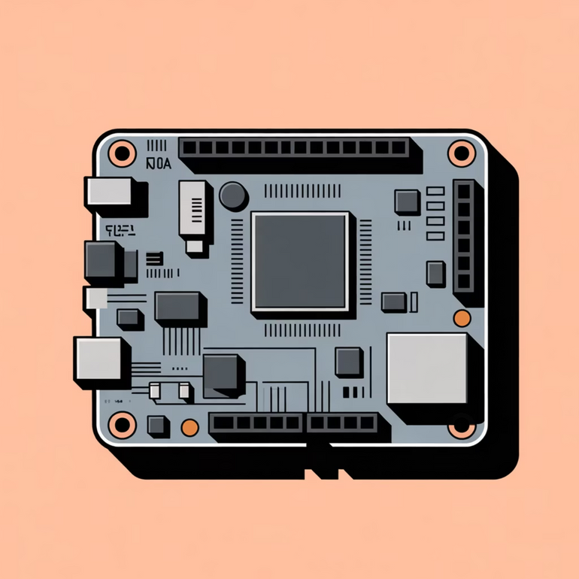

Module 1: Arduino Uno Microcontroller
The Arduino Uno serves as the central processing unit, bridging the gap between digital commands and physical light control.
The Brain of the System
PWM Capability
Utilizes dedicated Pulse Width Modulation (PWM) pins to allow for precise dimming of connected lights.
Processes incoming Bluetooth commands sent from the smartphone app.
Custom Logic
Runs firmware designed to interpret serial data and translate it into appropriate voltage signals for the light circuit.
Notes:
3

Slide 5
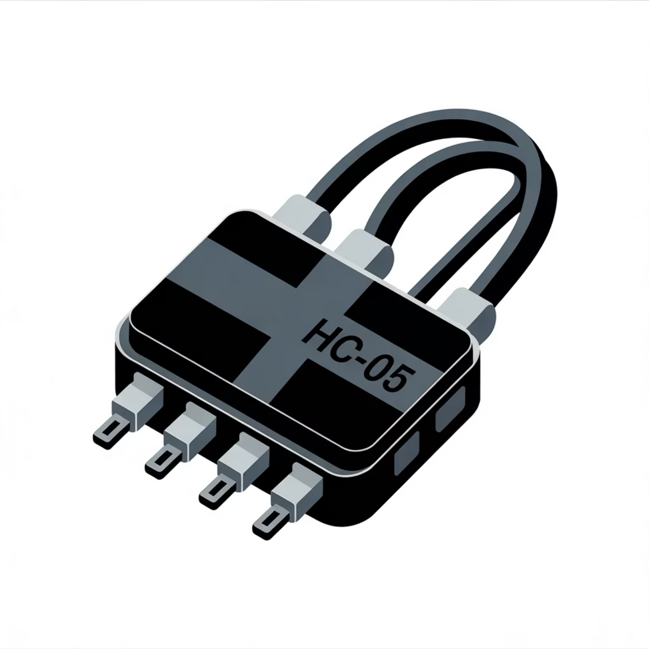
Module 2: HC-05 Bluetooth Module
The HC-05 provides the essential wireless link, allowing the system to be controlled remotely without physical connections.
Wireless Communication
Establishes a reliable Serial Port Profile (SPP) connection with the user's smartphone.
Simplified Interface
Data is transmitted serially; Arduino reads simple strings or characters to denote the desired light state or intensity level.
Standard Connectivity
Connects to the Arduino's hardware serial pins (TX/RX) for efficient, high-speed data transfer.
Notes:
4

Slide 6



Module 3: Light Control Hardware
This module handles the actual power delivery and light modulation based on the Arduino's digital output signals.
PWM Utilization
Component Choice (DC)
Component Choice (AC)
The core mechanism for dimming, where the Arduino's output signal is rapidly pulsed to control the effective voltage supplied to the light source.
For low-voltage DC applications, LEDs are directly controlled, often using a MOSFET or transistor to handle the current load.
For high-voltage AC bulbs, a relay module is necessary to safely switch the main power ON/OFF, or a TRIAC dimmer circuit for AC dimming.
The ability to use PWM pins ensures smooth, continuous intensity adjustment rather than just binary control.
Notes:
5

Slide 7
Essential Components List
Gathering the right hardware is the first step in building this low-cost, high-utility smart lighting system.
1
2
Arduino Uno
HC-05 Module
The primary microcontroller board.
The Bluetooth transceiver for wireless command transmission.
3
4
Driver Circuit
Lighting Elements
Relay module (AC) or MOSFET/Transistor (DC) for current switching/dimming.
LEDs or compatible dimmable light bulbs.
5
6
Accessories
Software Interface
Jumper wires, breadboard, power supply, and resistors.
A mobile app (e.g., Connectino, customized Bluetooth terminal) to send commands.
Notes:
6

Slide 8
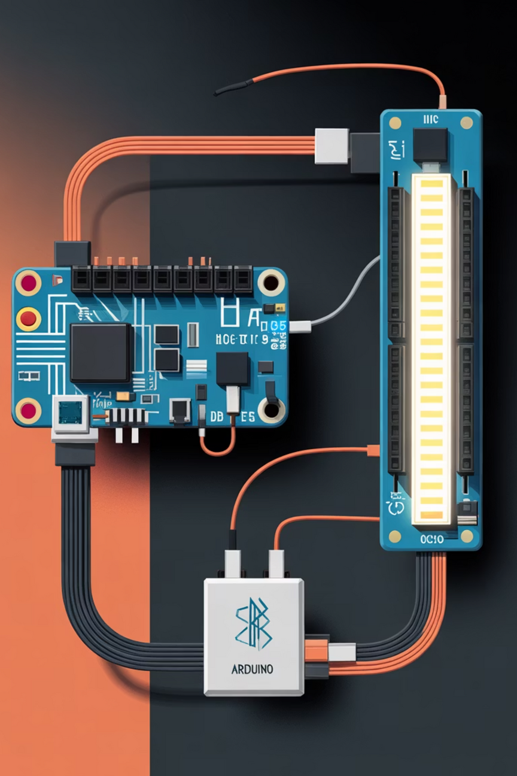
Critical Wiring & Connections
Proper component connection ensures reliable communication and safe light operation.
HC-05 Power
Connect VCC to Arduino 5V and GND to GND.
Serial Communication
HC-05 TX goes to Arduino RX (Pin 0), and RX goes to Arduino TX (Pin 1) for programming and initial setup.
Control Signal
Connect the signal pin of the Relay or the gate of the MOSFET driver to a dedicated Arduino PWM pin (e.g., Pin 9 or 10).
Light Circuitry
The light source (LED or AC bulb) must be correctly integrated with the driver, ensuring power safety and dimming compatibility.
Notes:
7

Slide 9
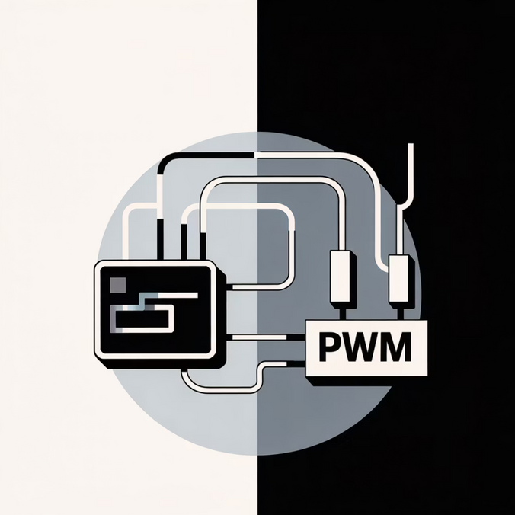

Control Logic & Code Highlights
The software determines how the system interprets commands and controls light output.
The Arduino program constantly monitors the Serial Port for incoming data from the HC-05.
Commands can be simple characters ("A" for On, "B" for Off) or a number (0-255) representing the desired brightness level.
Upon receiving a brightness value (0-255), the Arduino uses the analogWrite() function.
This function generates the corresponding PWM signal on the connected pin, which directly controls the light intensity.
Code Example Snippet:
int brightness_value = 150; // Value received via BluetoothanalogWrite(PWM_pin, brightness_value);
Notes:
8

Slide 10
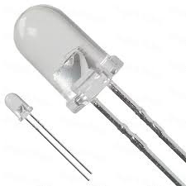
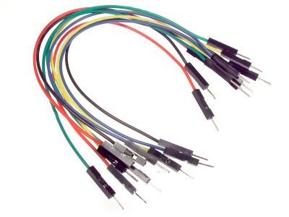
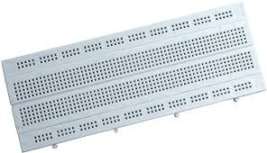
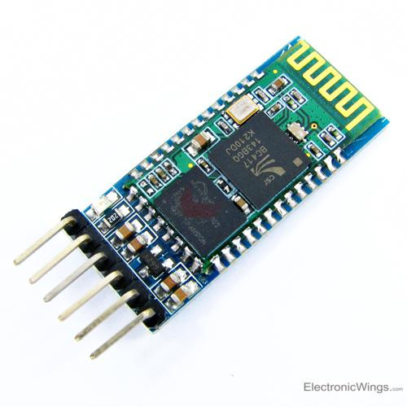
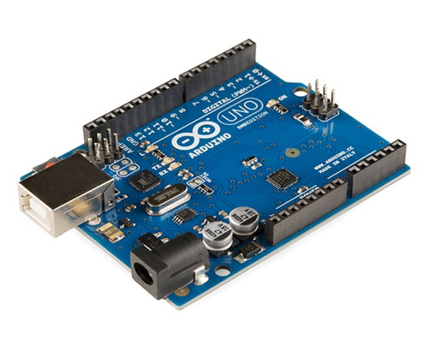
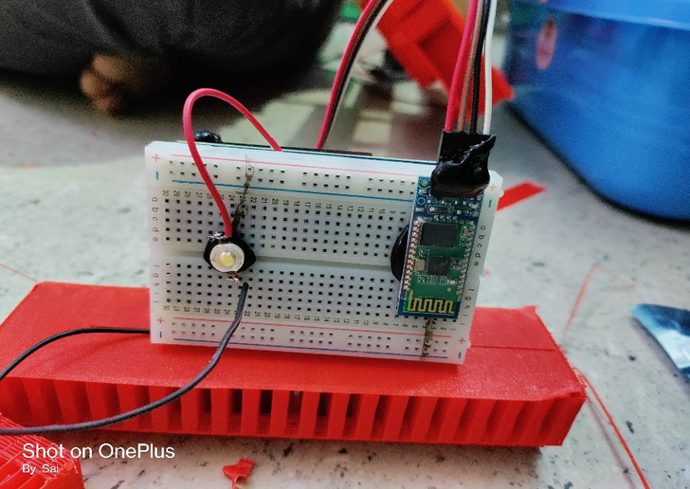
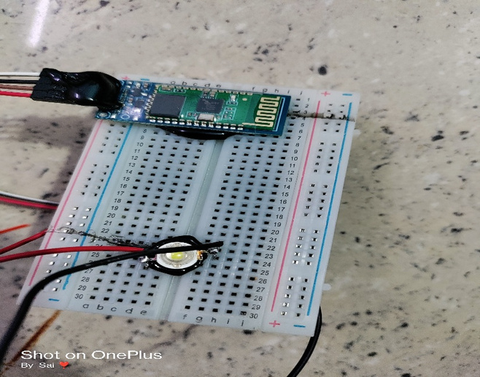
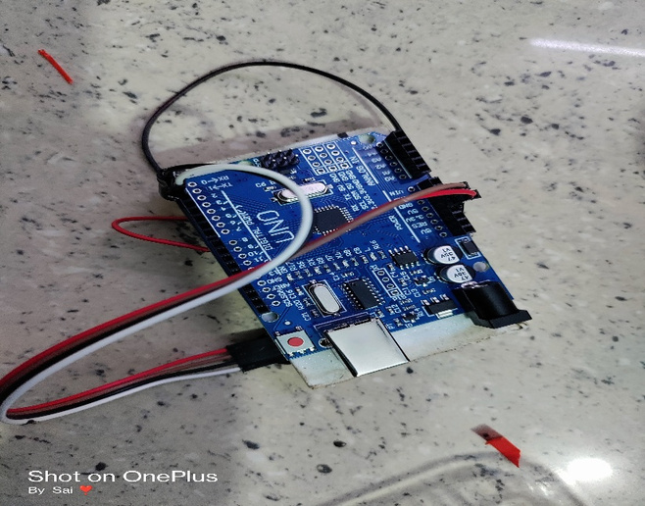
Components
Bread Board
Bluetooth Module
AURDINO UNO
LED
M-M wires
Output

Slide 11
Demonstration & Output
Seamless Ambiance Control
Mobile Interface
Real-Time Dimming
Key Benefits
The user interacts with a simple, intuitive app on their smartphone.
Light intensity changes instantaneously as the user moves the slider or taps a preset button.
Provides wireless convenience, significant energy savings through dimming, and highly customizable room ambiance.
Notes:
9

Slide 12



Conclusion & Next Steps
This proof-of-concept project establishes a foundation for advanced smart lighting systems.
Future Integration
Integrate external sensors (e.g., proximity or ambient light) for automatic intensity adjustment or hands-free voice control.
Enhanced Control
Upgrade to RGB LEDs and expand the control logic to manage color palettes and dynamic lighting effects.
Affordable Solution
Bluetooth and Arduino offer an affordable, flexible platform for building custom smart home automation features.
Notes:
10

